Slide 2
Module 2-– Lé Jèrriais - not’langue
– jerriais –- our language

Slide 3
Aniet, j’sommes à apprendre…
Today we are learning…
What some Jèrriais place names mean
How to ask someone their name and answer them

Slide 4
Many street names originally had Jèrriais or French names and due to the spread and uptake of English over time many were changed into English. Here are some examples;

Slide 5
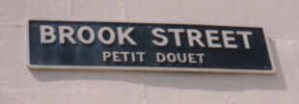

Slide 6
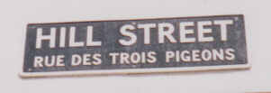

Slide 7
La Corbiéthe
the place of crows
the ship wreck
the hangman

Slide 8
Lé Viér Marchi
The Large Marsh/Swamp
The Old Market
The Place of Many Feet

Slide 9
Les Tchennevais
The Hemp Fields
The Sandy Place
The Oak Trees

Slide 10
Pliémont / La Grêve au Lachon
The Rainy Hill
Rock Pool Beach
Sand Eel Beach

Slide 11
Lé Stchez
The Place of Fallen Trees
The Dry Place
The Place of Rocks

Slide 12
Rouoge Bouoillon
The Place of Red Trees
The Red Marsh/Swamp
Red Soup

Slide 13
La Rue Driéthe
The Place of Prayer
The Bumpy Road
The Back Street

Slide 14
La Mouaie
The Sandy Fields
The Prison
The Pile of Stones

Slide 15
Tch’est qu’est tan nom? (What is your name?)

Slide 17
Tch’est qu’est tan nom?
Man nom est…
(my name is)

Slide 18
Man nom est Charlot

Slide 19
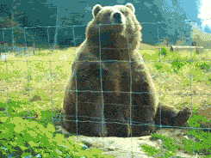
À bétôt
À bi

